Slide 1

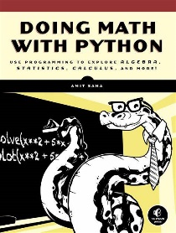

Doing Math with Python Opening and Intro
001
GitHub: https://github.com/yasenstar/DoingMathWithPython
Gitee: https://gitee.com/yasenstar/DoingMathWithPython
Yasen – Enterprise Architecture
YouTube: @yasenzhao

Slide 2
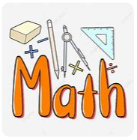
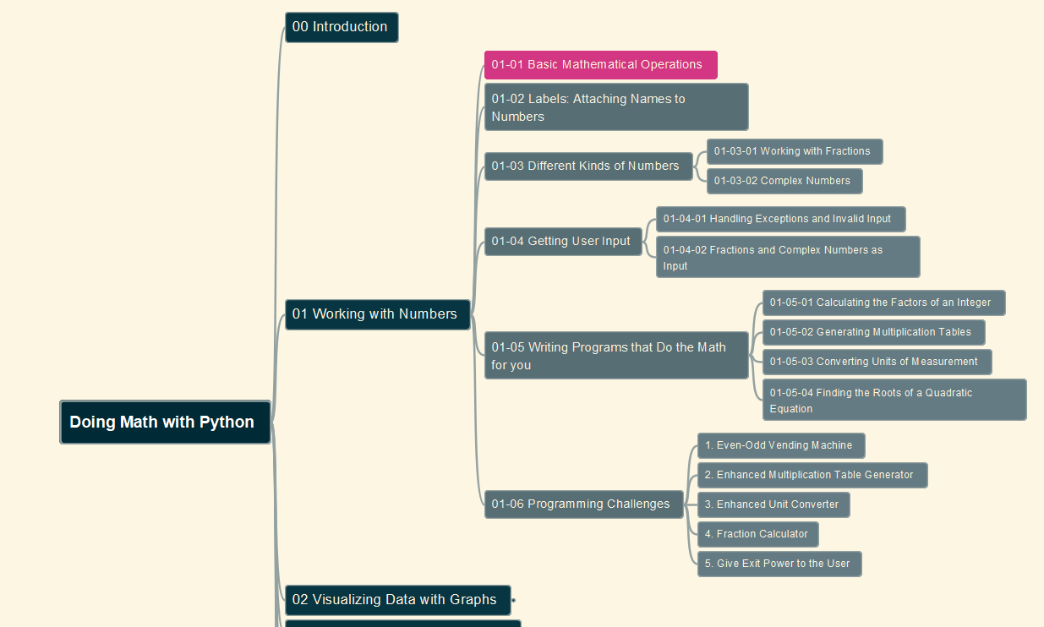
Doing Math with Python
002
Chapter 01: Working with Numbers
01-01 Basic Mathematical Operations
GitHub: https://github.com/yasenstar/DoingMathWithPython
Gitee: https://gitee.com/yasenstar/DoingMathWithPython
Yasen – Enterprise Architecture
YouTube: @yasenzhao

Slide 3
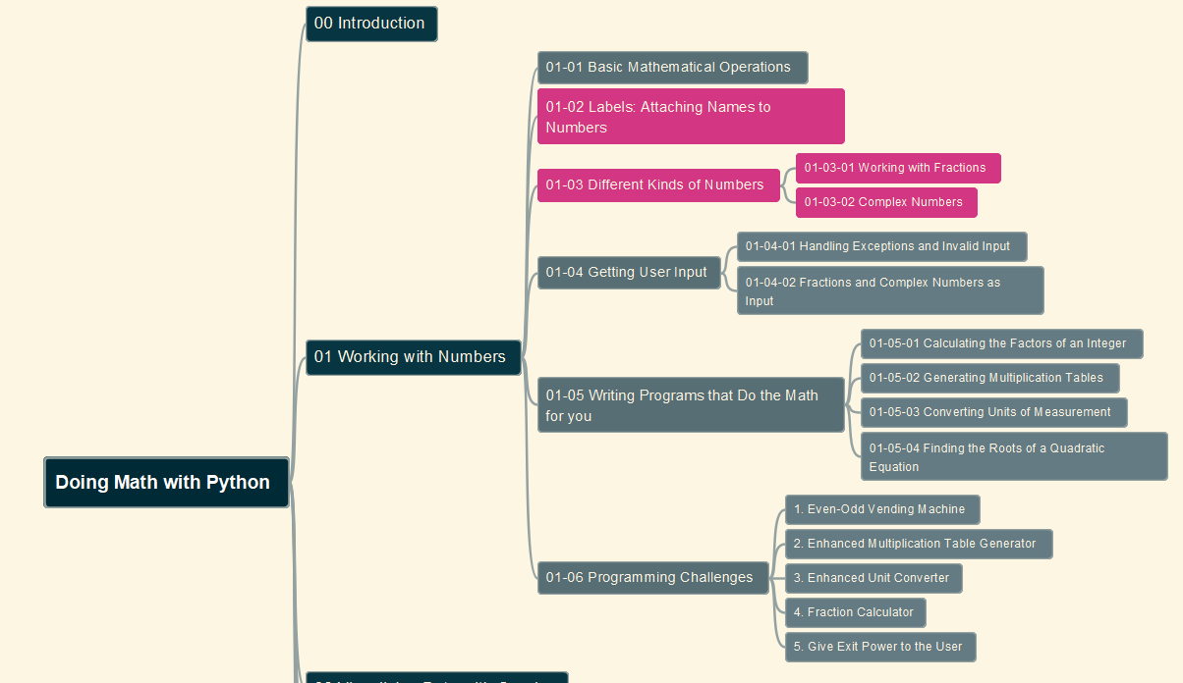
Doing Math with Python
003
Chapter 01: Working with Numbers
01-02 Labels: Attaching Names to Numbers
01-03 Different Kinds of Numbers
GitHub: https://github.com/yasenstar/DoingMathWithPython
Gitee: https://gitee.com/yasenstar/DoingMathWithPython
Yasen – Enterprise Architecture
YouTube: @yasenzhao

Slide 4
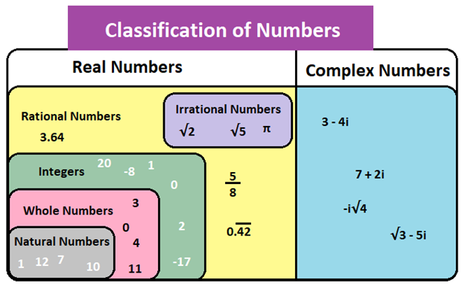
About Number’s Definition and Range

Slide 5
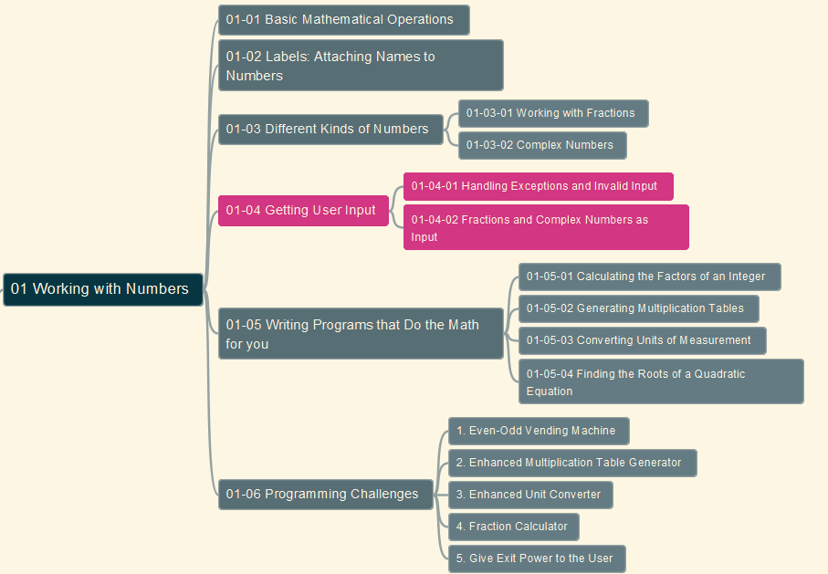
Doing Math with Python
004
Chapter 01: Working with Numbers
01-04 Getting User Input
GitHub: https://github.com/yasenstar/DoingMathWithPython
Gitee: https://gitee.com/yasenstar/DoingMathWithPython
Yasen – Enterprise Architecture
YouTube: @yasenzhao

Slide 6
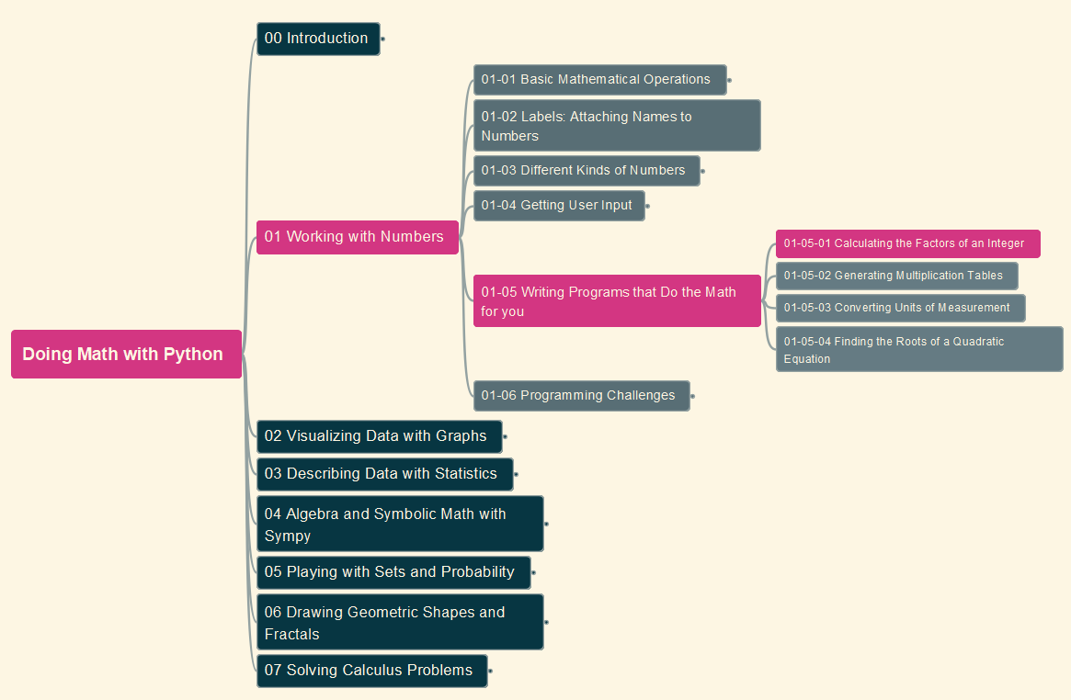
Doing Math with Python
005
Chapter 01: Working with Numbers
01-05 Writing Programs that Do the Math (1)
GitHub: https://github.com/yasenstar/DoingMathWithPython
Gitee: https://gitee.com/yasenstar/DoingMathWithPython
Yasen – Enterprise Architecture
YouTube: @yasenzhao

Slide 7

Doing Math with Python
006
Chapter 01: Working with Numbers
01-05 Writing Programs that Do the Math (2)
GitHub: https://github.com/yasenstar/DoingMathWithPython
Gitee: https://gitee.com/yasenstar/DoingMathWithPython
Yasen – Enterprise Architecture
YouTube: @yasenzhao

Slide 8
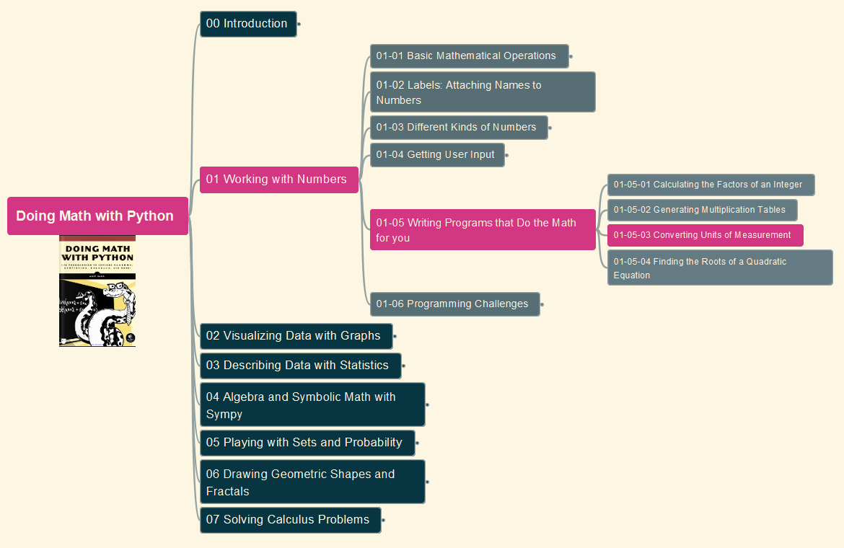
Doing Math with Python
007
Chapter 01: Working with Numbers
01-05 Writing Programs that Do the Math (3)
GitHub: https://github.com/yasenstar/DoingMathWithPython
Gitee: https://gitee.com/yasenstar/DoingMathWithPython
Yasen – Enterprise Architecture
YouTube: @yasenzhao

Slide 9
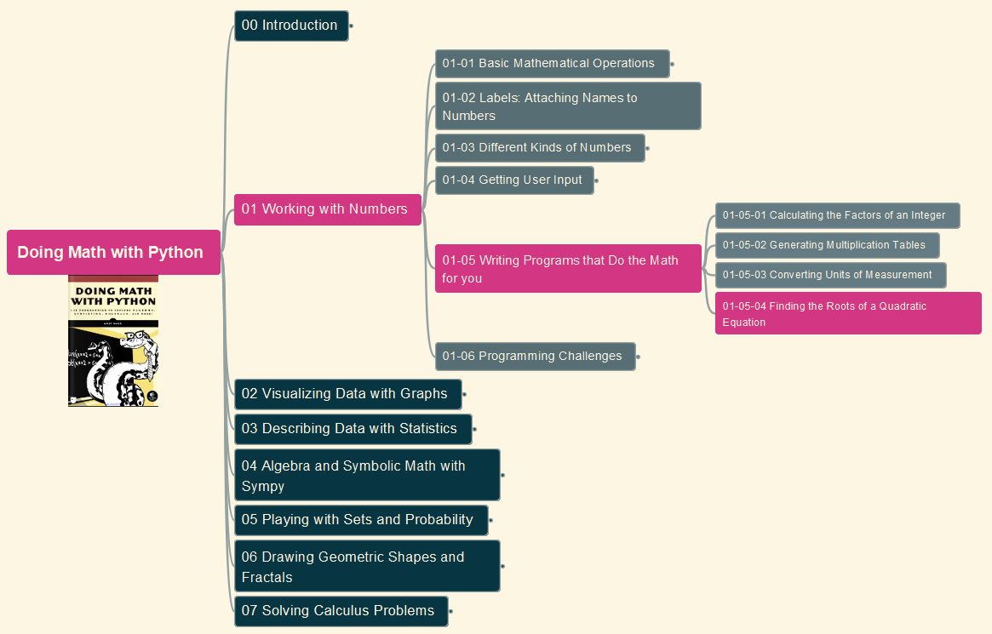
Doing Math with Python
008
Chapter 01: Working with Numbers
01-05 Writing Programs that Do the Math (4)
GitHub: https://github.com/yasenstar/DoingMathWithPython
Gitee: https://gitee.com/yasenstar/DoingMathWithPython
Yasen – Enterprise Architecture
YouTube: @yasenzhao

